Slide 1
Modular PIPs
Shaziya Tambawala
UX Design
July 2015

Slide 2
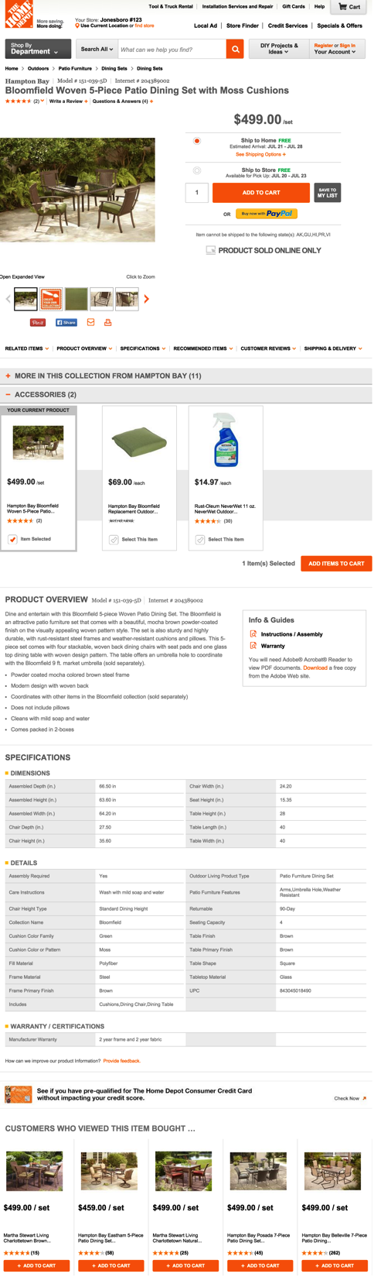
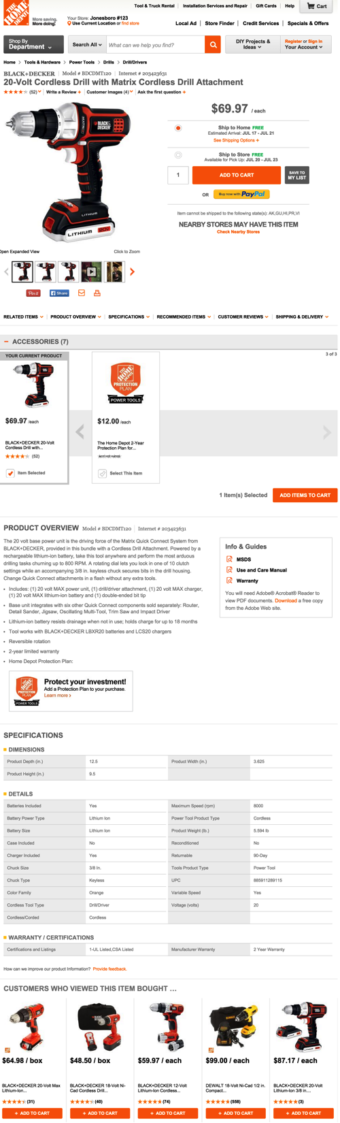
Project Description
PIPs have the same layout across the board
A concept exploration to make PIPs more dynamic with widgets
How can we display PIPs based on:
Product department/category
Information relevant to customer’s journey

Slide 3
Project Goals
Goals:
Allow for a more streamlined customer experience
Make relevant content more transparent
Potential Success Metrics:
Incremental expected cart adds for PIP are estimated at 1M
Customer engagement through increased number of Reviews and Q&A
Time on page for task
Notes:
Avg. cart value = $40
Estimated value of Modular PIP ~ $40M
Therefore, incremental expected cart adds for PIP are 1M

Slide 4
Project Status
Assessed 18 retail sites for best practices
Aligned with different teams in and outside the PIP work stream
Defined 3 PIP buckets and regrouped content
Designed low fidelity simulation based on commonly shopped cross categories
Study to determine impact on usability
Design iteration based on feedback

Slide 5
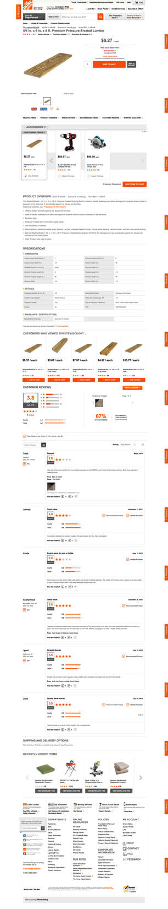
What are PIP modules?
Image Gallery
Pricing and Fulfillment
Product Overview
Specifications
Frequently Bought Together
Compare Similar Items
IRG
More In This Collection
Accessories
Coordinating Items
Certona
Questions & Answers
Ratings & Reviews
Recently Viewed

Slide 6
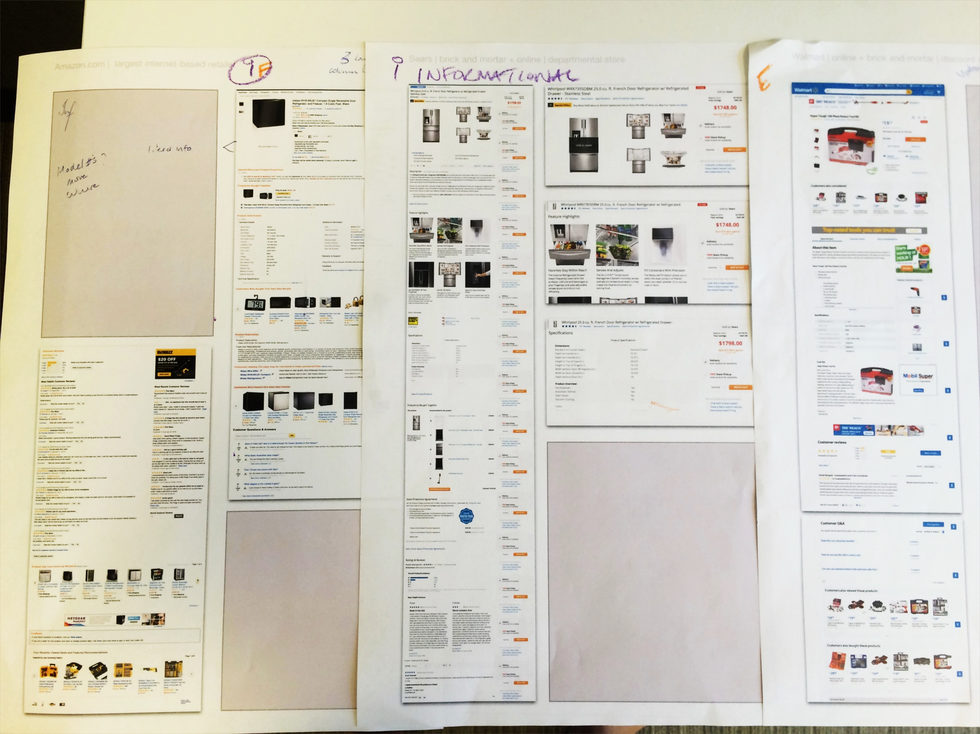
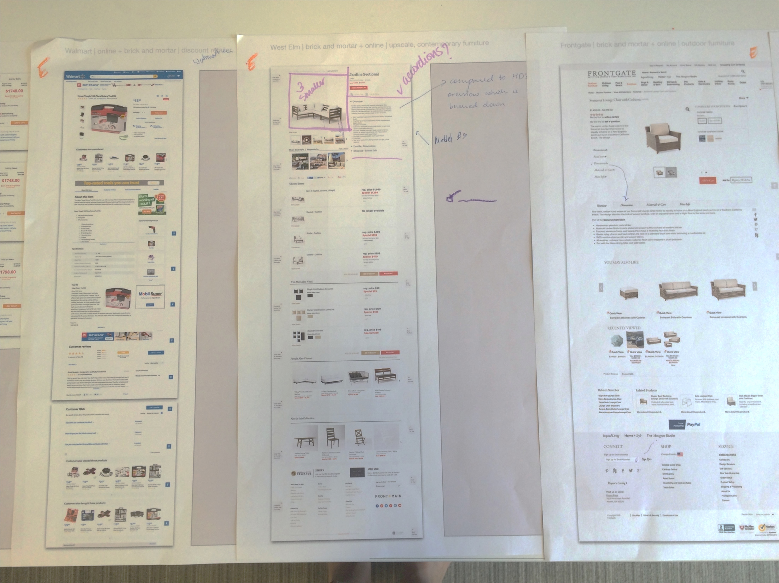
Project Status
Assessed 18 retail sites for best practices
Modules/Content topics
Average ~ 6
Standard deviation ~ 3
Content exposure on PIP
Open = 56%
Closed = 44%
Notes:
Reviewed product pages for their usability and content from direct competitors like Lowes, Walmart, Amazon as well as other retail sites like Patagonia, Nike, Etsy – some of which are related to and some are outside the home improvement industry.
Compared to HD’s 11 content topics (what I will call modules), competitors average at 6, with a standard deviation of approximately 3.
Content exposure was analyzed for a tabbed vs scroll/open experience which is almost equally split up. The disadvantage of the tabbed experience is that it doesn’t have clear hierarchy for the content.
Decisions we made from the analysis: retain the open scroll but try and reduce the content topics by eliminating non-relevant upsellers (more on that in Project Findings)

Slide 7
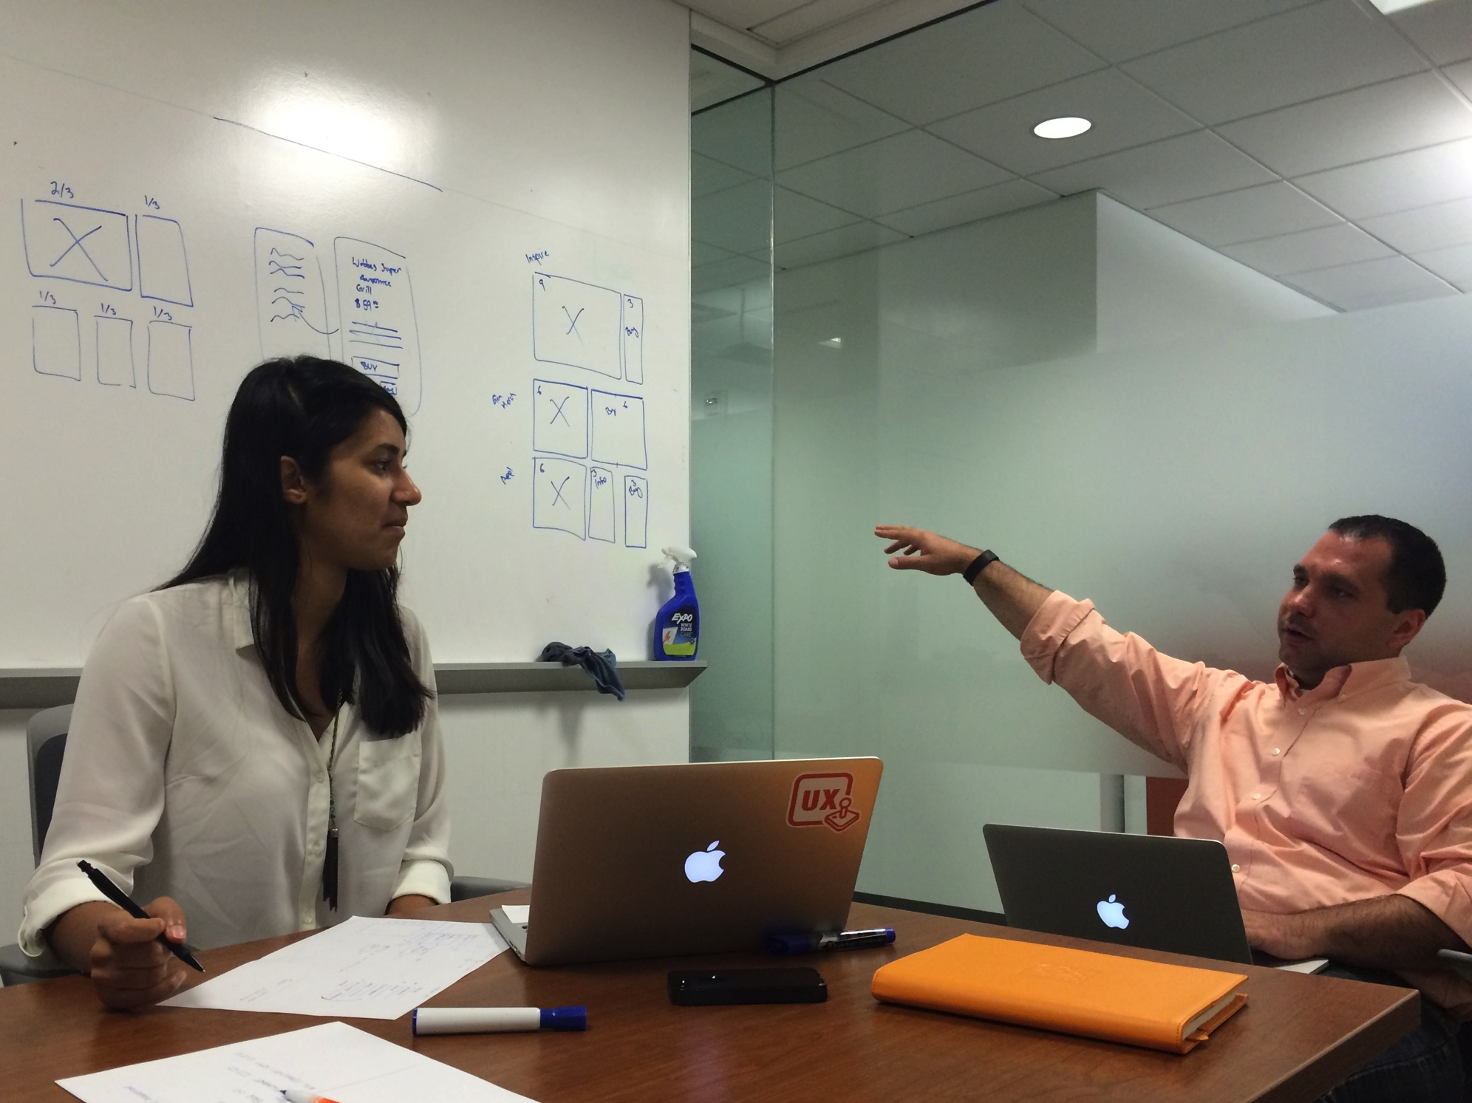
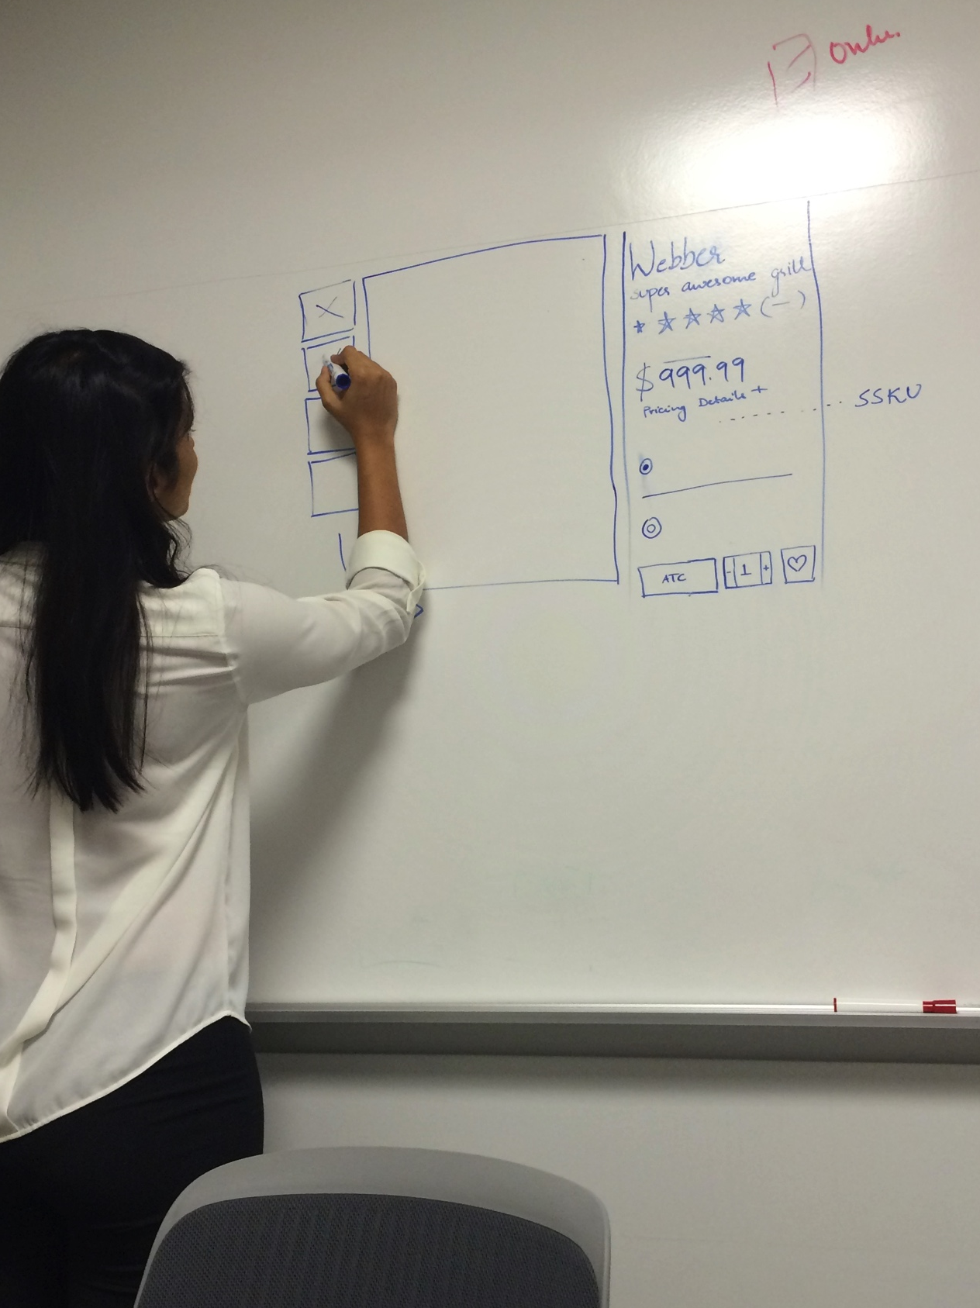
Project Status
Aligned with Category Experience, Digital Asset Execution and Product Management teams to define 3 PIP buckets
Educational | Informational | Inspirational
Deeper dive with UX team to explore re-grouping of content
Notes:
Began with locking in Zone A and then went from there.
Addressed the cross-platform experience.
Force ranked the different modules of the PIP and stacked them up accordingly.

Slide 8
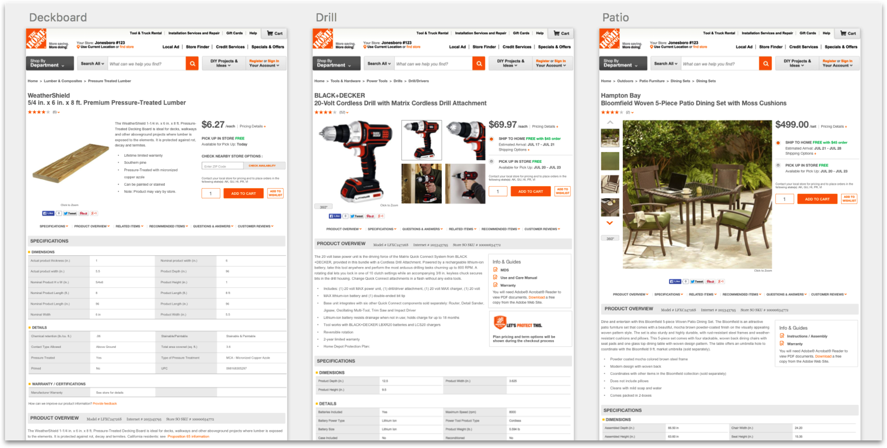
Project Status
Notes:
Began with locking in Zone A and then went from there.
Addressed the cross-platform experience.
Force ranked the different modules of the PIP and stacked them up accordingly.

Slide 9
Project Status
Completed study with 10 participants to understand impact on usability when browsing across 2 categories
Findability
“I didn’t notice it was anywhere different…I don’t think [the quick links] being in a different order makes much difference”
“I think if, for each product the "most important" item was displayed first, that would be best. I can see how maybe someone might be confused by the shuffling around (i.e. my dad would gripe about it) But I'm pretty tech savvy, so it didn't bother me”
General Impression
“This does not have affect on shopping experience, I actually quite like it. Simply because a drill is a complicated device that needs an overview before specifications“
“If I’m buying two things I don’t think it wouldn’t matter. I didn’t even notice. If I was buying a lot of things, I would like layout to be consistent; that would definitively have an affect on my shopping experience if it was constantly changing or if it varied by product or department"
Notes:
Scoped it down to 2 commonly shopped cross categories products for the purposes of this project. One concern that Kevin Hoffman shared was will it not be a jarring experience to have differing layouts?
Based on cross-category shopping analysis provided by product team, Jan to June 2015:
Lumber to building materials: 11.4%
Building materials to lumber: 8.6%
Outside garden to inside garden: 8.3%
Prototype navigation was limited, clickable areas included:
Home Depot logo (to homepage)
Shop by Department and Certona for applicable products
Did usability study to understand whether reorganizing of content had an impact on the shopping experience.
Understand if there is difficulty finding information on two PIPs when information is located in different modules.
Understand general impression of cross-category shopping on PIPs with different layouts.
Most participants did not appear to have or say they had difficulty finding information located in different places on the two pages they viewed. Others expected to find information to be in the same location on both pages

Slide 10
Project Challenges
Frequency of enhancements to PIP
Cross-platform design
End-to-end view: fitting into the larger story of PLP and category pages
Conflicting data
Earlier collaboration with usability to better scope project
Notes:
While the goal is clear, the scope of the project spans multiple workstreams with frequent enhancements that often clutter the PIP rather than streamline it.
Talked to so many people with so much data that things were conflicting. While collaborating I didn’t really have a clear vision, but it all came together at the end.

Slide 11
Project Findings / Recommendations
Split test to determine any affect on conversion across all categories as results could vary by category and cross-category
Content and cross-sell recommendations should be relevant to the product
Widgetize each PIP module
Scaling by including more product categories based on customer journeys
Notes:
Gonna work with Seth and Sara to hand it off..
Partner with PIP workstream to get more cross-category analysis
Action: Based on general impression of participants in the user study, split test would be necessary to determine any affect on conversion across all categories as results could vary by category and cross-category
Keeping in mind the excess of content modules, we eliminated content that didn’t support the product. So each product now has 9 modules, which was decided through force ranking with Product Management.
From a business perspective, questions on where is conversion most important need to be addressed (IRG, Certona, FBT, GBB)?
Widgetize each PIP module so that they can be reordered dynamically to surface most important content.
Action: Reconsider module location changes from category to category; less distance between placements from page to page limited customer confusion. Scaling based on customer journeys.

Slide 12
Thank You!
Questions?

